Slide 1
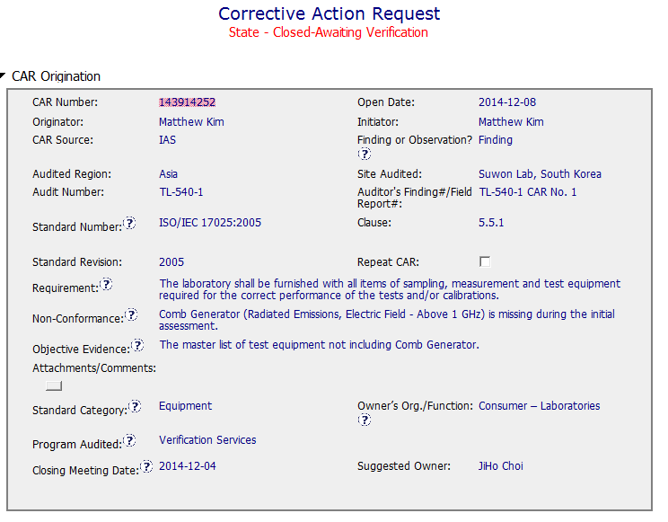
Finding: CAR 143914252
Background
A bit more detail in the NC and Obj Evidence would have been helpful to understand what was driving the NCR.
First reaction to the non-conformance was “So what!”
Turns out, this was the initial IAS Accreditation Audit for the new EMC Lab and they did not have all the required equipment at the time of the audit. IAS TL-673

Slide 2
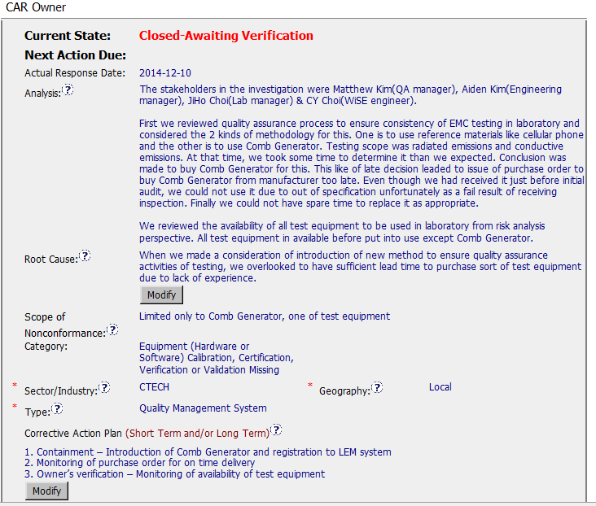
Finding: CAR 143914252
Relevant Stakeholders identified.
Analysis / Scope: seems appropriate. Appears there were 2 methods to conduct the testing. And they took more time than expected to chose which method to use. Then underestimated the time to acquire the needed equipment prior to the audit.
Owner
response
Root cause fits the analysis.
Scope is appropriate per the analysis.

Slide 3
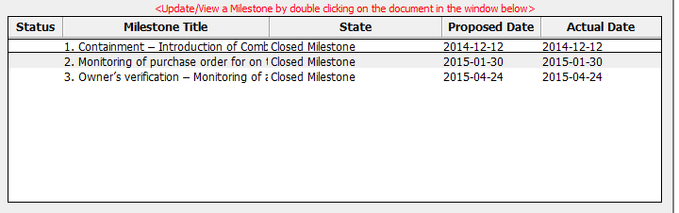
Finding: CAR 143914252
Milestones
Containment Milestone: LEM shows equipment went into service 2 days after the CAR was generated.
It appears that the equipment was already on order and they were trying to be compliant prior to the audit.
Recommendations for improvement: Details known during the audit not present in the CAR & would assist in understanding..

Slide 4
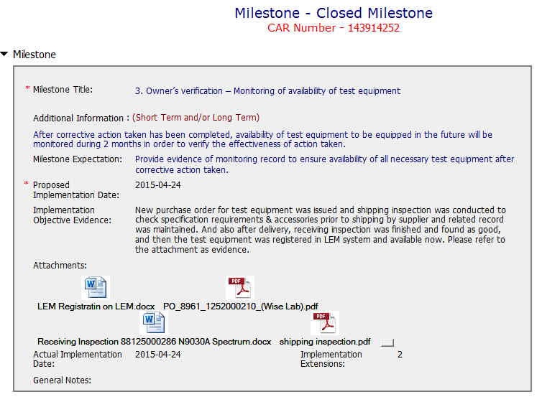
Finding
Next 2 milestones address the identified Root Cause.
MS#2 created a Shipping Inspection Log to track delivery dates.
MS#3 shows process in action.

Slide 5
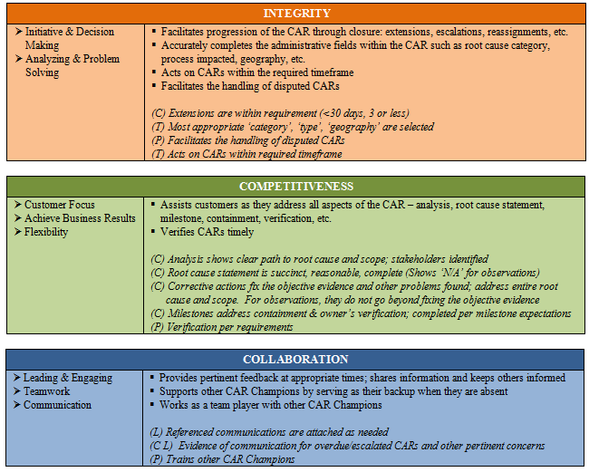

Acted quickly to address CAR. Analysis in 2 days, First milestone completed just 4 days after CAR was submitted.
Document History shows CAR Champion providing feedback to help completing the Owner Verification.

Slide 6
THANK YOU

Slide 7
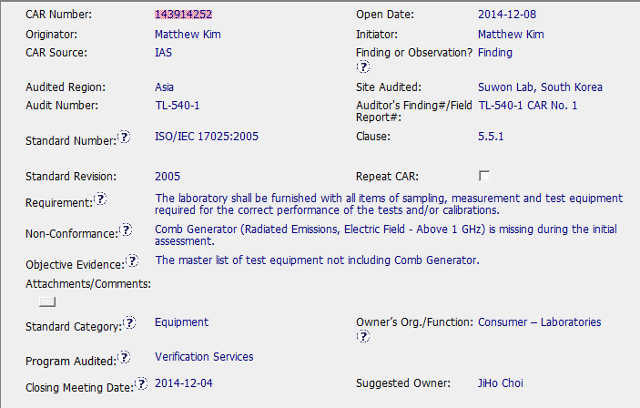
CAR 143914252
Audit not entered into the Audit Calendar

Slide 8
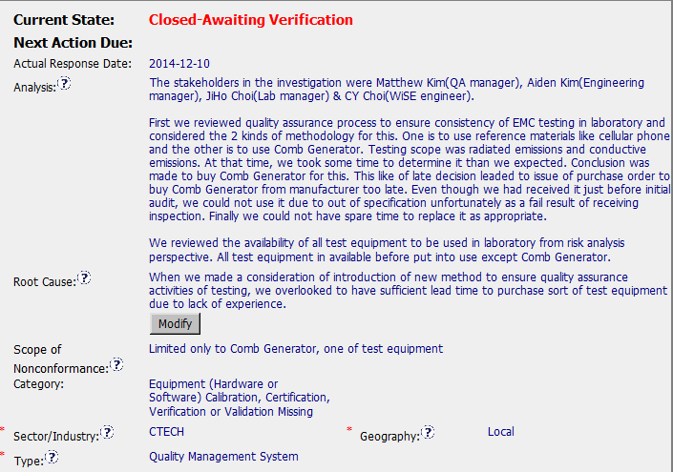
CAR 143914252
Stakeholders identified
Clear path to root cause
How tests requiring generator were performed

Slide 9
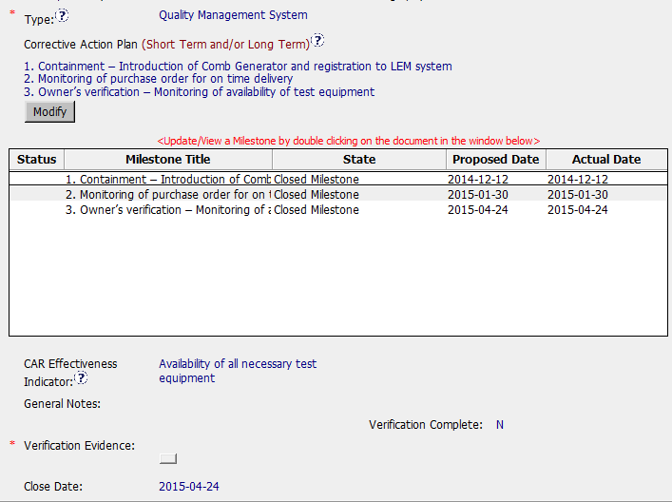
CAR 143914252
CA Plan and milestones are appropriate.

Slide 10
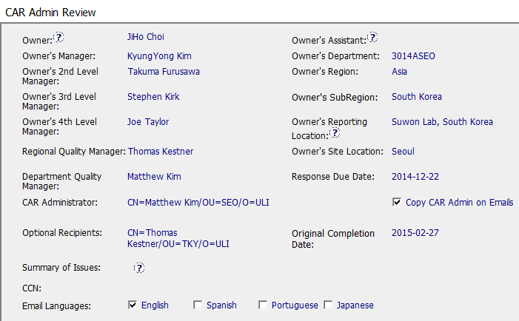
CAR 143914252
All fields completed appropriately.

Slide 11
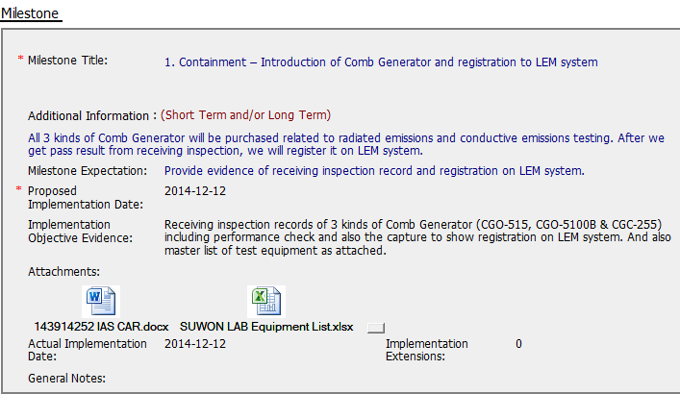
CAR 143914252
Milestone expectation OK
Evidence provided OK

Slide 12
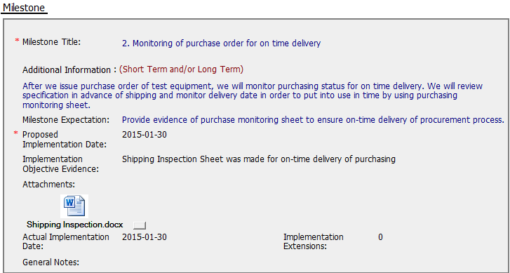
CAR 143914252
Milestone expectation OK
Evidence provided OK

Slide 13
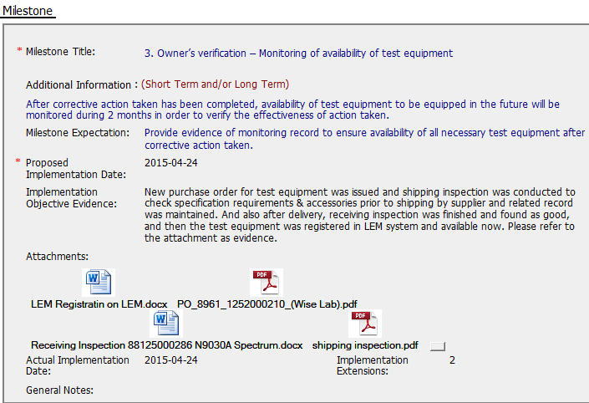
CAR 143914252
Milestone expectation OK
Evidence provided OK

Slide 14
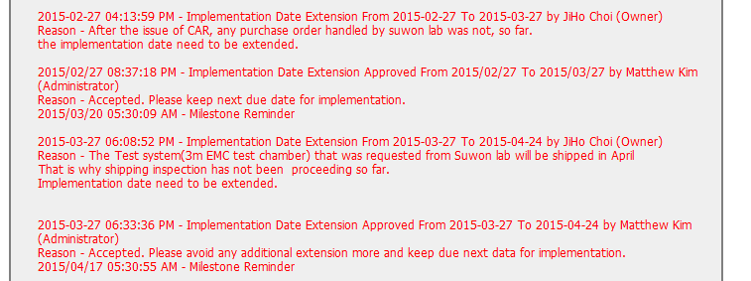
CAR 143914252
Extension requests supported appropriately
Nice method to stop extension requests!!

Slide 15




CAR 143914252
INTEGRITY
Initiative & Decision Making Analyzing & Problem Solving | Facilitates progression of the CAR through closure: extensions, escalations, reassignments, etc. Accurately completes the administrative fields within the CAR such as root cause category, process impacted, geography, etc. Acts on CARs within the required timeframe Facilitates the handling of disputed CARs NA (C) Extensions are within requirement (<30 days, 3 or less) (T) Most appropriate ‘category’, ‘type’, ‘geography’ are selected (P) Facilitates the handling of disputed CARs (T) Acts on CARs within required timeframe
COMPETITIVENESS
Customer Focus Achieve Business Results Flexibility | Assists customers as they address all aspects of the CAR – analysis, root cause statement, milestone, containment, verification, etc. Verifies CARs timely (C) Analysis shows clear path to root cause and scope; stakeholders identified (C) Root cause statement is succinct, reasonable, complete (Shows ‘N/A’ for observations) (C) Corrective actions fix the objective evidence and other problems found; address entire root cause and scope. For observations, they do not go beyond fixing the objective evidence (C) Milestones address containment & owner’s verification; completed per milestone expectations (P) Verification per requirements
COLLABORATION
Leading & Engaging Teamwork Communication | Provides pertinent feedback at appropriate times; shares information and keeps others informed Supports other CAR Champions by serving as their backup when they are absent Works as a team player with other CAR Champions (L) Referenced communications are attached as needed (C L) Evidence of communication for overdue/escalated CARs and other pertinent concerns (P) Trains other CAR Champions
CL

